Slide 1
Lesson 2
精讲听力
雅思听力组

Slide 2


Job Hunting

Slide 3
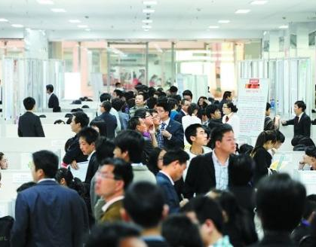



Possible way
Labor market
Personnel market
Student Job Centre
Internet
Newspaper
Advertisement

Slide 4

Job Interview
interviewer
interviewee

Slide 5

简历
Personal Information
Education Background
Activities，Work Experience
Awards, Achievements
Skills, qualification
Reference
CV (Curriculum Vitae)/ Resume

Slide 6


临时工作 or 固定工作
temporary job
permanent job

Slide 7


兼职 or 全职
Part-time job
Full-time job

Slide 8

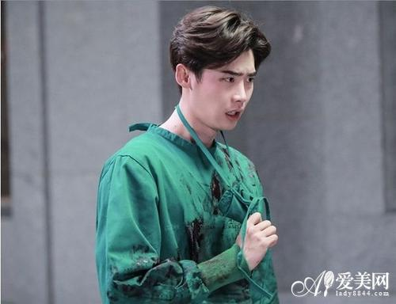


Occupation
-er/or
teacher
engineer
lawyer
reporter
officer
professor
actor/actress
editor
-ist
artist
dentist
journalist
scientist
pianist
violinist
student
secretary
accountant
architect
critic
volunteer

Slide 9

vacant
空缺的
branches
部门 子公司
recruit
招募
quality
才能
referee
介绍人 裁判

Slide 10
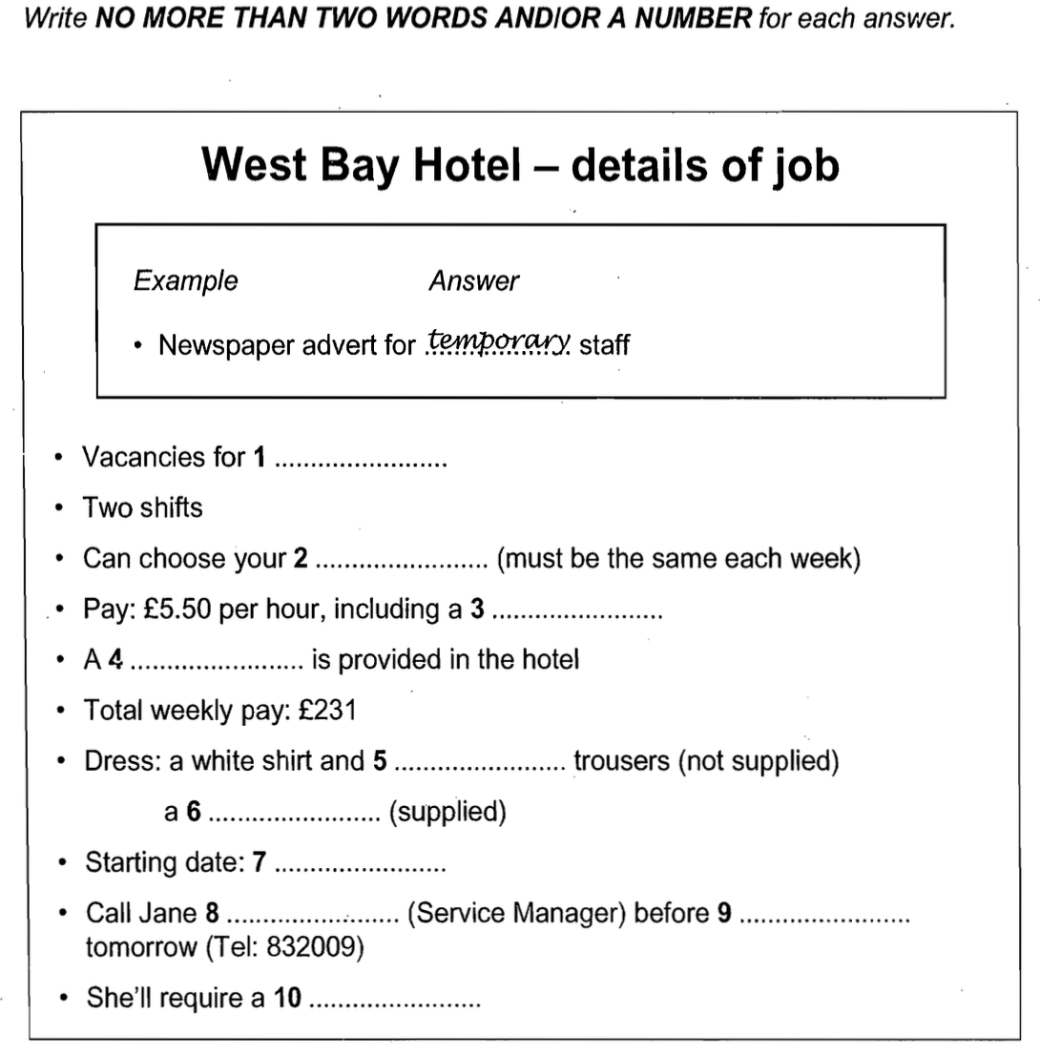
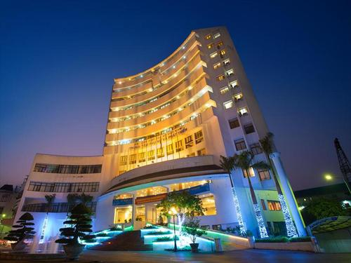
8-4-1 P81

Slide 11
8-4-1 P81
waiters
day off
break
meal
dark
jacket
12.00/（pm）
/noon
/mid-day
28 June
Urwin
reference
ask for

Slide 12
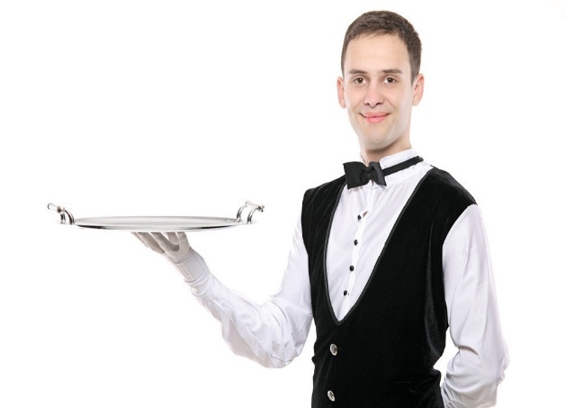





waiter/waitress
salesman
security guard
chef/cook
photographer
engineer

Slide 13
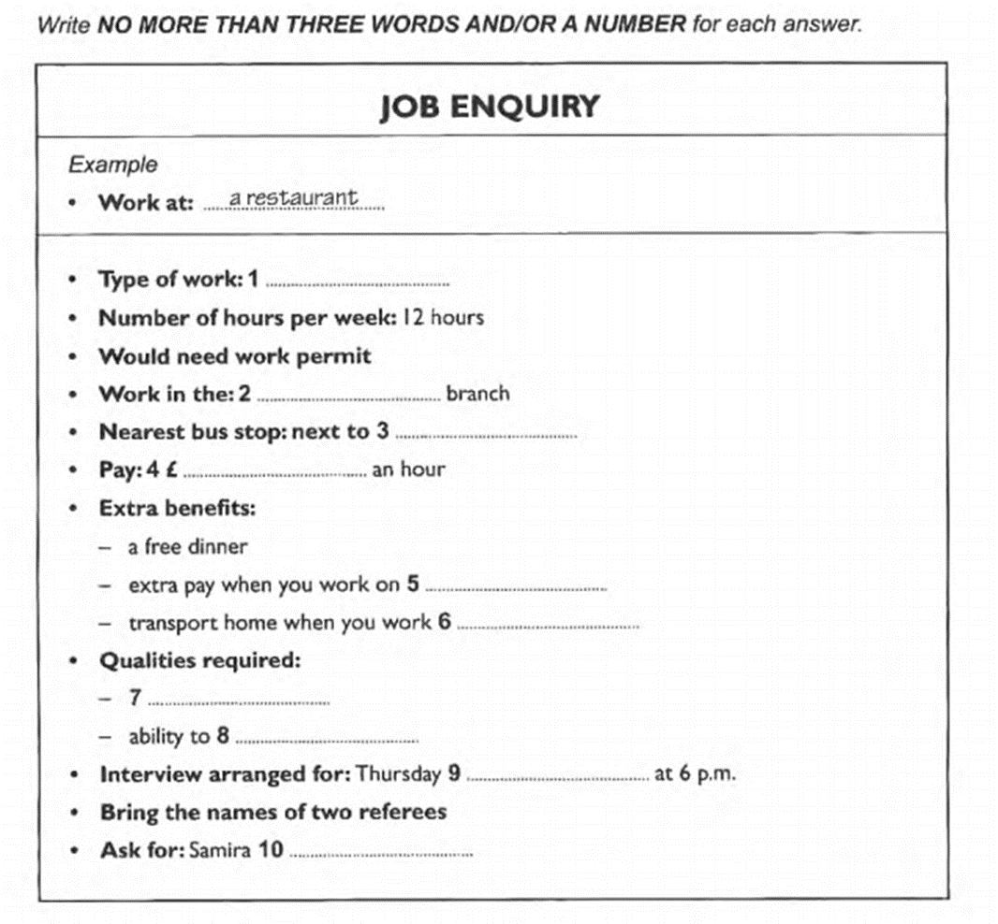
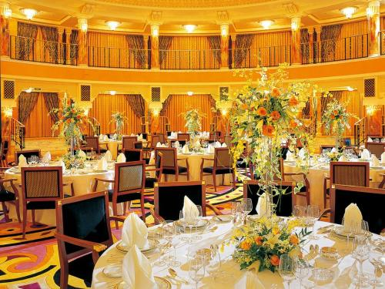
9-1-1 P10

Slide 14
9-1-1 P10
answering (the) phone
Hillsdunne Road
library
4.45
national holidays
after 11 (o’clock)
clear voice
think
22 October
Maunja

Slide 15

Medical treatment

Slide 16
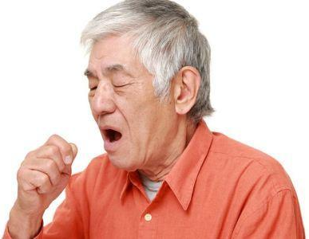
illness/diseases
cough
Feel ill / sick
catch a cold / get flu
sneeze
get a running nose
headache
Sore throat
Infection
Drowsiness
Dizzy

Slide 17
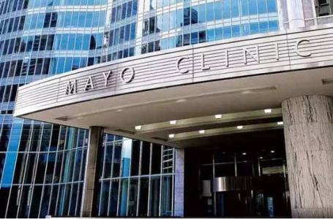

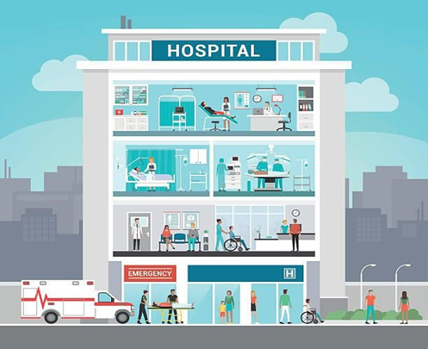

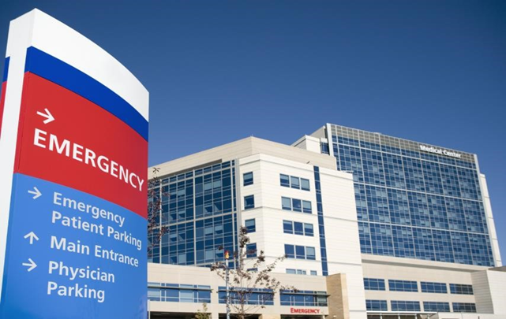
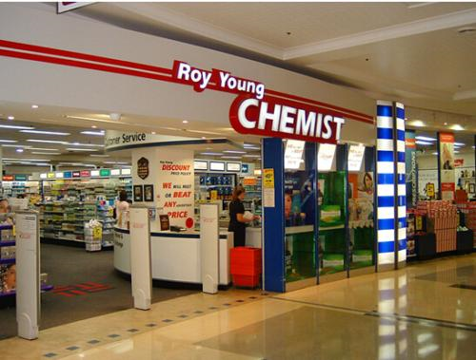
clinic
Community health center
hospital
ambulance
Emergency room/center
A&E (accident and emergency)
Chemist’s

Slide 18

Doctor
内科
外科
牙科
全科
Physician
Surgeon
Dentist
General Practitioner（GP）
therapist
psychologist

Slide 19
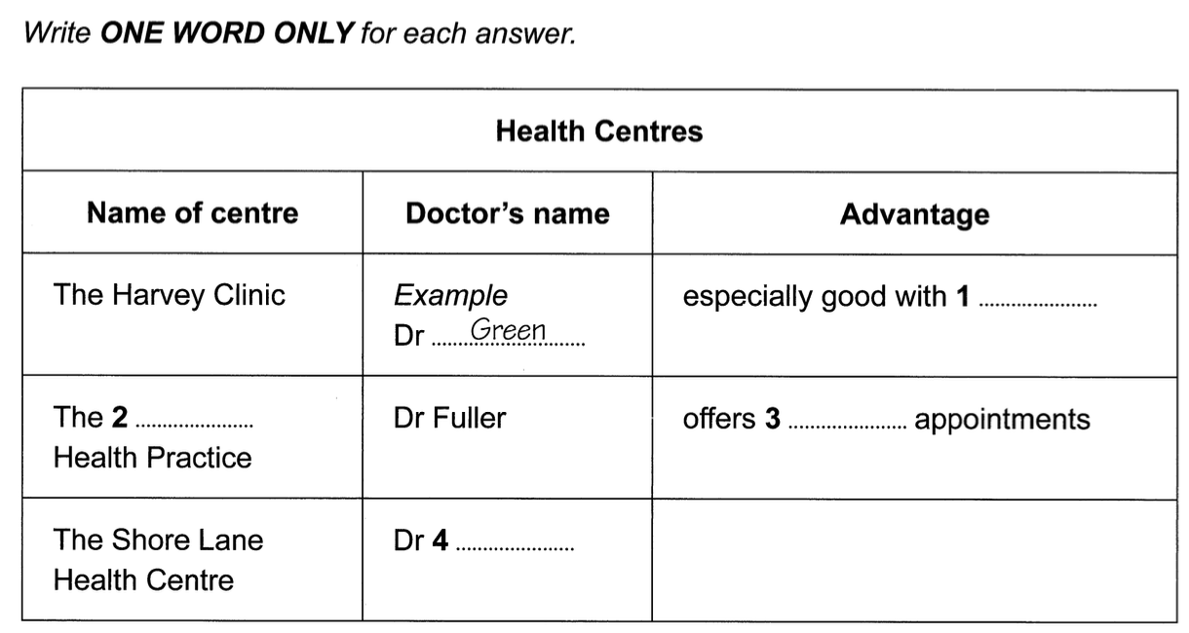
9-4-1 P79

Slide 20
9-4-1 P79
babies
Eshcol
evening
Gormley

Slide 21
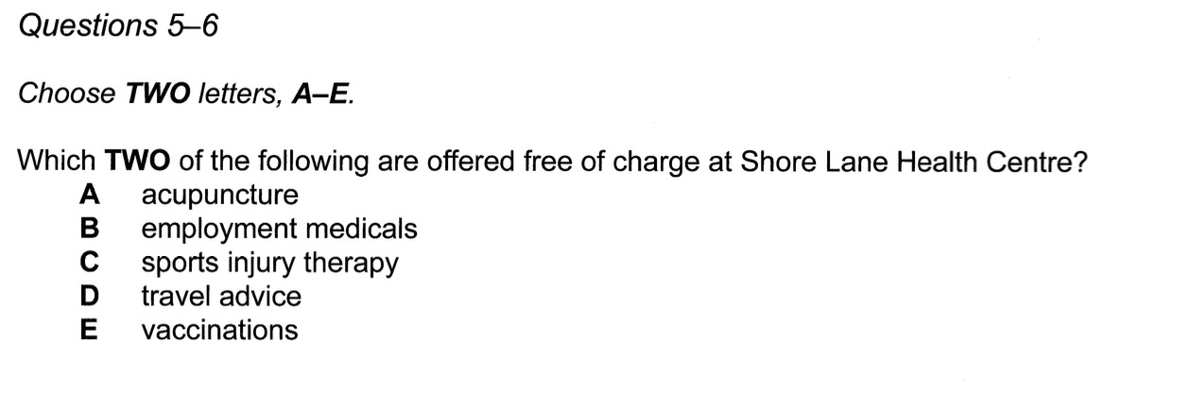

Slide 22
BE
Operates on a paying basis
As part of their pay-to-use service
vaccinated
Before a new employer will accept you
…
a free fitness check-up there

Slide 23
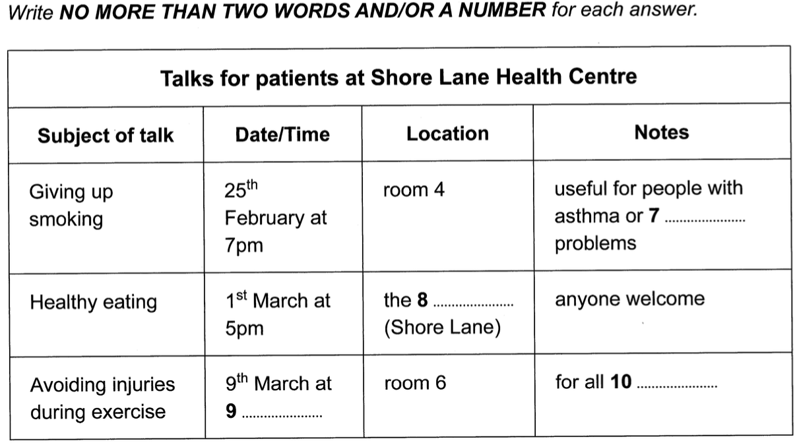

Slide 24
heart
primary school
ages
4:30

Slide 25

vocabulary
预约
make an appointment with
给病人做手术
operate on a patient /perform an operation on
给某人注射某物
inject sb with sth
给…注射疫苗
vaccinate
药房
pharmacy
药方
prescription

Slide 26

diseases
心脏病
肥胖症
糖尿病
哮喘
失眠症
营养不良
过敏
Heart diseases
obesity / overweight
diabetes
asthma
insomnia
malnutrition
allergy

Slide 27
homework
雅思听力机经场景词汇汇编：记背工作场景、医疗场景单词
2）完成5-3-1，6-2-1，6-3-1，7-3-1，10-3-1

